Slide 1





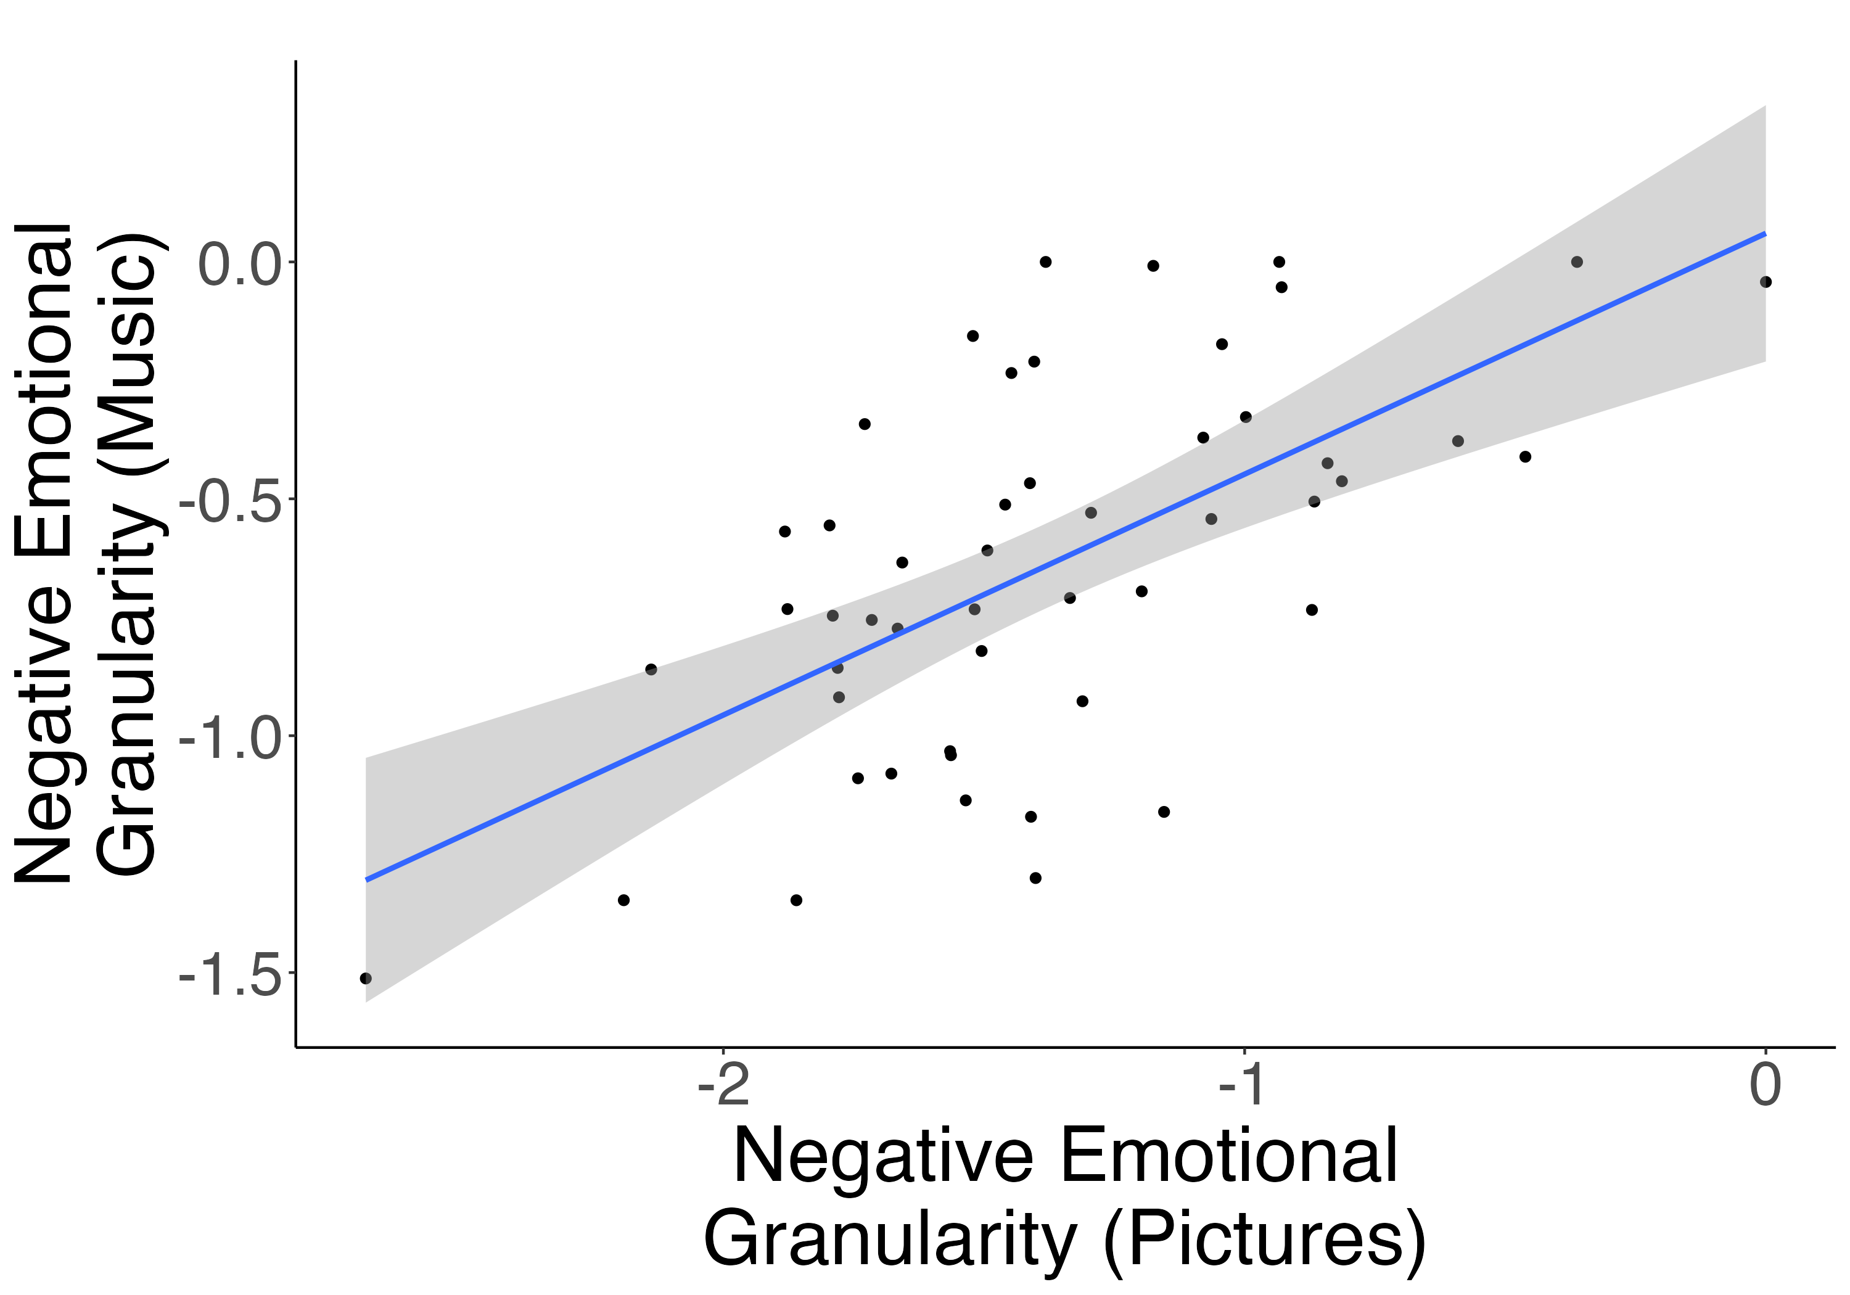
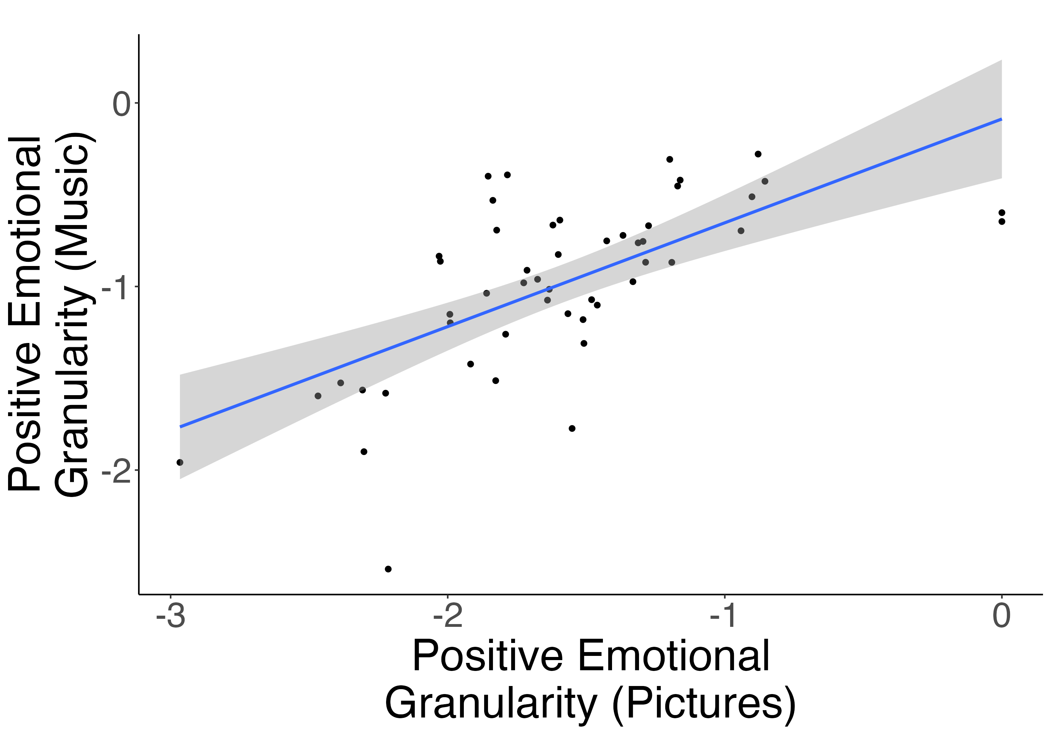







Measuring Emotional Granularity with Music
Fahim Ahmed¹, Nicholas Kathios², Laurel Gabard-Durnam², Psyche Loui²
¹Harvard University, Cambridge MA
²Northeastern University, Boston, MA
Background
Emotion Rating Task
Music elicits greater based differentiation for arousal-based images
Emotional granularity describes the degree to which people categorize or differentiate experiences of affect¹
One approach to measuring emotional granularity involves responding to affective images²
Music listening is an emotionally evocative experience that allows listeners to traverse emotional space over time and is often cited as a regulatory behavior³
Listening to music may involve more nuanced experiences of emotion compared to viewing static pictures and thus may be an effective way to measure emotional granularity
Listen to this clip.
Correlations between positive emotion
ratings in response to music
Correlations between positive emotion
ratings in response to pictures
OR
excited
excited
8s
joyful
joyful
How _____ were you while listening to that music or viewing that image?
relaxed
relaxed
satisfied
satisfied
anxious
0
Not at all
relaxed
happy
happy
100
Extremely
happy
satisfied
relaxed
excited
happy
satisfied
joyful
excited
joyful
0
Not at all
gloomy
100
Extremely
excited
relaxed
Correlations between negative emotion
ratings in response to pictures
0
Not at all
happy
100
Extremely
0
Not at all
100
Extremely
Correlations between negative emotion
ratings in response to music
0
Not at all
upset
upset
upset
0
Not at all
100
Extremely
100
Extremely
anxious
anxious
0
Not at all
sad
satisfied
100
Extremely
0
Not at all
100
Extremely
scared
scared
0
Not at all
scared
joyful
sad
sad
Hypothesis: Emotional granularity in response to music and pictures would correlate, but that music would elicit a more granular emotional response than pictures.
100
Extremely
0
Not at all
100
Extremely
Emotion words chosen based on those commonly used in emotional granularity tasks¹², along with those commonly cited to be evoked by music¹³
Emotional granularity scores = -1 X intraclass correlation coefficient (ICC) of emotion ratings (higher scores = greater granularity)¹⁴
Granularity scores separately calculated for music and pictures and positively- vs. negatively-valenced emotions (4 measures per participant)
gloomy
gloomy
gloomy
sad
anxious
scared
gloomy
upset
sad
scared
anxious
upset
Methods
Emotional granularity experienced in response to music unrelated to musical training and mental health
STUDY 1:
N = 72 (51F; mean age = 18.6 years)
Completed emotion rating task (see “Emotion Rating Task”) and psychometric survey battery, consisting of the Goldsmith Musical Sophistication Index⁴ (Gold-MSI), State-Trait Anxiety Inventory⁵ (STAI), Conor-Davidson Resilience Scale-10⁶ (CD.RISC-10), and Beck Depression Inventory⁷ (BDI), and the Range and Differentiation of Emotional Experience Scale⁸ (RDEES)
STUDY 2:
• N = 50 (28F; mean age = 21 years)
Completed emotion rating task and psychometric survey battery, consisting of Gold-MSI, BDI, RDEES, and Screen for Anxiety Related Disorders (SCAARED)⁹
Negative Granularity Score: Pictures
Positive Granularity Score: Pictures
Negative Granularity Score: Music
Positive Granularity Score: Music
RDEES: Differentiation Score
Formal Musical Training
STAI Trait Score
Emotional granularity scores are correlated across music and pictures
RDEES: Range Score
CD.RISC Score
STAI Trait Score
CD.RISC Score
RDEES Score
Formal Musical Training
BDI Score
BDI Score
Study 1
RDEES: Range Score
Study 1
RDEES: Differentiation Score
RDEES Score
Negative Granularity Score: Music
Positive Granularity Score: Music
Negative Granularity Score: Pictures
r(70) = .51, p < .001
Positive Granularity Score: Pictures
r(70) = .58, p < .001
Stimulus Selection for Emotion Rating Task
Study 2
Negative Granularity Score: Pictures
Positive Granularity Score: Pictures
Negative Granularity Score: Music
Positive Granularity Score: Music
Sixteen affective images (all non-social) drawn from the Open Affective Standardized Image Set¹⁰ (OASIS) using normed data
RDEES: Differentiation Score
Formal Musical Training
RDEES: Range Score
Formal Musical Training
SCAARED Score
BDI Score
RDEES Score
BDI Score
RDEES: Range Score
r(48) = .65, p < .001
r(48) = .62, p < .001
RDEES: Differentiation Score
Study 2
RDEES Score
Music and pictures evoked comparable magnitude of emotions, but music elicited more granular emotional responses than images
SCAARED Score
Negative Granularity Score: Music
Positive Granularity Score: Music
Negative Granularity Score: Pictures
Positive Granularity Score: Pictures
Study 1
Discussion
Emotional granularity elicited by pictures and music were strongly correlated, suggesting these two approaches are measuring the same psychological construct
More granular emotional experiences listening to music is potentially driven by greater arousal-based differentiation
Future studies should disentangle whether greater granularity in response to music is due to greater co-occurrence of emotions or a more dynamic emotional experience
Pictures
Music
Sixteen music excerpts drawn from longer music compositions composed to portray specific emotion states¹¹ using normed data
Start of excerpt
End of excerpt
To listen to the excerpts:
Study 2
References
Barrett, L. F., Gross, J., Christensen, T. C., & Benvenuto, M. (2001). Knowing what you’re feeling and knowing what to do about it: Mapping the relation between emotion differentiation and emotion regulation. Cognition and Emotion, 15(6), 713–724. https://doi.org/10.1080/02699930143000239
Nook, E. C., Sasse, S. F., Lambert, H. K., McLaughlin, K. A., & Somerville, L. H. (2018). The Nonlinear Development of Emotion Differentiation: Granular Emotional Experience Is Low in Adolescence. Psychological Science, 29(8), 1346–1357. https://doi.org/10.1177/0956797618773357
Granot, R., Spitz, D. H., Cherki, B. R., Loui, P., Timmers, R., Schaefer, R. S., Vuoskoski, J. K., Cárdenas-Soler, R.-N., Soares-Quadros, J. F., Li, S., Lega, C., La Rocca, S., Martínez, I. C., Tanco, M., Marchiano, M., Martínez-Castilla, P., Pérez-Acosta, G., Martínez-Ezquerro, J. D., Gutiérrez-Blasco, I. M., … Israel, S. (2021). “Help! I Need Somebody”: Music as a Global Resource for Obtaining Wellbeing Goals in Times of Crisis. Frontiers in Psychology, 12. https://doi.org/10.3389/fpsyg.2021.648013
Müllensiefen, D., Gingras, B., Musil, J., & Stewart, L. (2014). The Musicality of Non-Musicians: An Index for Assessing Musical Sophistication in the General Population. PLOS ONE, 9(2), e89642.
Spielberger, C. D., Gorsuch, R. L., Lushene, R., Vagg, P. R., & Jacobs, L. (1970). Manual for the state-trait anxiety inventory. Consult. Psychol.
Connor, K. M., & Davidson, J. R. T. (2003). Development of a new resilience scale: The Connor-Davidson Resilience Scale (CD-RISC). Depression and Anxiety, 18(2), 76–82. https://doi.org/10.1002/da.10113
Beck, A. T., Steer, R. A., & Brown, G. (1996). Beck Depression Inventory–II [Dataset]. https://doi.org/10.1037/t00742-000
Kang, S.-M., & Shaver, P. R. (2004). Individual Differences in Emotional Complexity: Their Psychological Implications. Journal of Personality, 72(4), 687–726. https://doi.org/10.1111/j.0022-3506.2004.00277.x
Angulo, M., Rooks, B. T., Gill, M., Goldstein, T., Sakolsky, D., Goldstein, B., Monk, K., Hickey, M. B., Diler, R. S., Hafeman, D., Merranko, J., Axelson, D., & Birmaher, B. (2017). Psychometrics of the screen for adult anxiety related disorders (SCAARED)- A new scale for the assessment of DSM-5 anxiety disorders. Psychiatry Research, 253, 84–90. https://doi.org/10.1016/j.psychres.2017.02.034
Kurdi, B., Lozano, S., & Banaji, M. R. (2017). Introducing the Open Affective Standardized Image Set (OASIS). Behavior Research Methods, 49(2), 457–470. https://doi.org/10.3758/s13428-016-0715-3
McClay, M., Sachs, M. E., & Clewett, D. (2023). Dynamic emotional states shape the episodic structure of memory. Nature Communications, 14(1), 6533. https://doi.org/10.1038/s41467-023-42241-2
Erbas, Y., Sels, L., Ceulemans, E., & Kuppens, P. (2016). Feeling Me, Feeling You: The Relation Between Emotion Differentiation and Empathic Accuracy. Social Psychological and Personality Science, 7(3), 240–247. https://doi.org/10.1177/1948550616633504
Hevner, K. (1936). Experimental Studies of the Elements of Expression in Music. The American Journal of Psychology, 48(2), 246–268. https://doi.org/10.2307/1415746
Erbas, Y., Ceulemans, E., Blanke, E. S., Sels, L., Fischer, A., & Kuppens, P. (2019). Emotion differentiation dissected: Between-category, within-category, and integral emotion differentiation, and their relation to well-being. Cognition and Emotion, 33(2), 258–271. https://doi.org/10.1080/02699931.2018.1465894
Supported by NIH R01AG078376, NIH R21AG075232, NSF-BCS 2240330 and NSF-CAREER 1945436, and Sony Faculty Innovation Award to PL and NSF GRFP awarded to NK.
fahmed@college.harvard.edu

